Slide 1

T3 Assessment

Slide 2
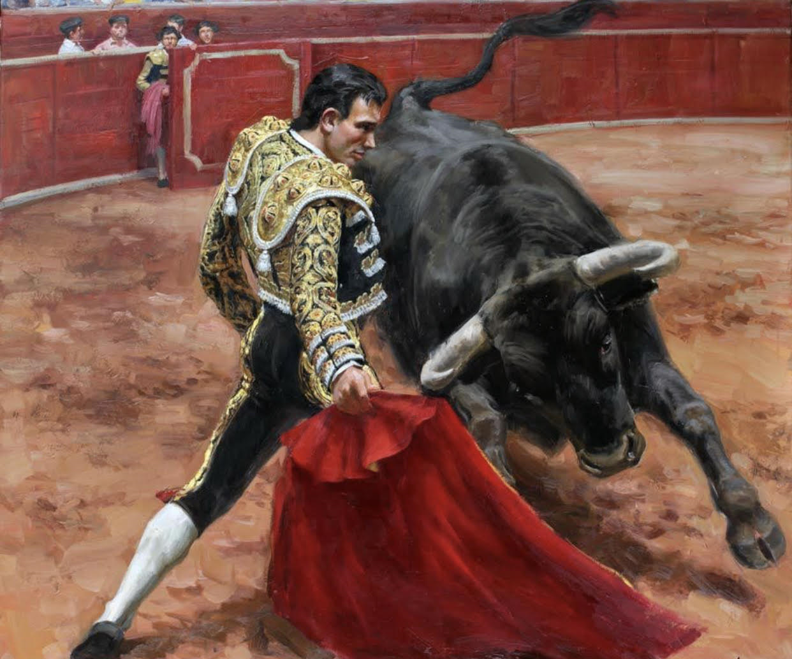
Group- Pampolona
S.No | Semester | Class | Name | Roll.No
1 | IV | CSE A | Aman Arora | 2K17CS00007
2 |  | ME
3 |  | DTEA
4 |  | CSE C
5 |  | CSE C

Slide 3

TODO SOBRE

Slide 4

Ques. 1 Guess the language which uses the upside down question mark in the beginning?
e.g. ¿…………………………………?
French
German
Spanish

Slide 5

c. Spanish

